Slide 1
Training: Introduction to Supervisory Control and Data Acquisition (SCADA)

Slide 2
WOP2 training modules
Introduction to NRW and DMA management
DMA caretaker approach
DMA construction & commissioning
SCADA
Benchmarking

Slide 3
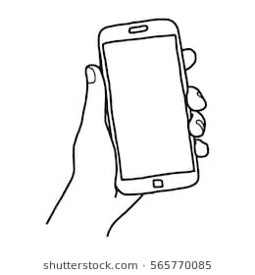



Rules and agreements

Slide 4
Objectives of the training
After this training,
Participants know what SCADA is and how it works.
Participants will understand the application of SCADA.
Participants understand in what ways SCADA can help improve DMA management.
Participants are able to access SCADA data and use data from the SCADA system.
Participants know what the correct installation of the physical components of a SCADA system looks like.

Slide 5
Planning for the next two days
Day 1:
Introduction to SCADA
Operation of SCADA
Installation of SCADA
Maintenance of SCADA
Day 2:
Field visit
Exercise with SCADA software
Reflection on SCADA system

Slide 6
Exercise: key word method “SCADA”
What is SCADA?
Step 1: In small groups, discuss words that you associate with SCADA and write those down on a poster paper.
Step 2: Underline the most important words.
Step 3: Use the underlined words to come up with a definition of SCADA.
Step 4: Present the definition.

Slide 7
SCADA – Definition
SCADA stands for: Supervisory Control & Data Acquisition (SCADA)
It is technology to collect data and monitor the performance of the water production and distribution processes.
It is an application that can help to increase efficiency, lower costs and increase the profitability of operations by turning data into information.

Slide 8
What is the present and future use of SCADA?
At present DWASA uses SCADA mainly for:
“Visualization” = see what is happening
In future DWASA can use SCADA for
“Automatization” = work with data in a more comprehensive way and operate remotely
Automation of a pressurized water network

Slide 9
Components of SCADA
SCADA encompasses two components:
Component 1: The first component is the equipment that is installed in water distribution network we want to monitor and control.
Component 2: The second component is the network of intelligent devices called Remote Terminal Units (RTU) and/or Programmable logical controller (PLC). RTU’s and PLC’s are able to send and receive information for monitoring and operation.

Slide 10
How does a SCADA System work?
Data acquisition through sensors
Data transfer using communication network
Data presentation
Control

Slide 11
SCADA system parameters
Pump on/off & pump running time
Power consumption
Chlorine cylinder full or empty
Pressure & flow
Failures & pump malfunctioning
Water level in well/ Dry-running protection system
Water sensor in DMA chamber

Slide 12
SCADA system outputs
Alarm analysis
Trend analysis
Periodic reports

Slide 13
Exercise: Advantages and disadvantages of SCADA (1)
Form groups of 4-5.
Brainstorm on what you think are the advantages and disadvantages of a SCADA system in a DMA.
Write down the advantages and disadvantages on a brown paper.

Slide 14
Exercise advantages and disadvantages of SCADA (2)
Advantages of SCADA | Disadvantages of SCADA

Slide 15
Exercise: SCADA flowchart
Form groups of 4-5.
Put the pieces in the right order on a brown paper to create the SCADA flowchart.
Reflect in your group what happens in each stage.
Present your flowchart.

Slide 16
SCADA system Flow: PUZZLE!!
SCADA Room (Operation)
Reporting & Analysis
SCADA Server
Sensors
Conversing
Storage
Measuring
Through Internet
Laptop/ Tablet (operation)
RTU/PLC
Reading
Sending
Database

Slide 17
Exercise: Equipment needed in a SCADA system
Brainstorm in small groups.
Using the flowchart, think what physical equipment is needed.
Draw a table for 5 segment of the flowchart on brown paper.
In every segment - like measuring, conversing, sending, storage and reading - put the name of the physical equipment in column.
Present your table.

Slide 18
Equipment Table
Name of the segment | Name of the equipment | Purpose of the equipment
Measuring
Conversing
Sending
Storage
Reading

Slide 19
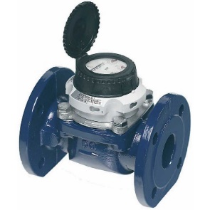
Equipment and task: Reflection by the participants.
Bulk water flow meter
A water flow meter is needed for measuring the amount of water passing through a pipe. The meter creates a pulse signal and transmits them to SCADA system or data loggers

Slide 20
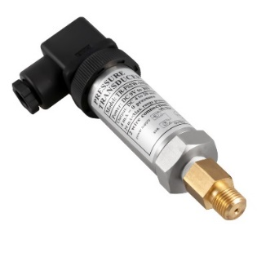
Equipment and task: Reflection by the participants.
Pressure Sensor
Pressure sensor is capable to detect the system pressure and convert it in an electrical signal. This allows the pressure to be monitored by SCADA or other relevant systems.

Slide 21
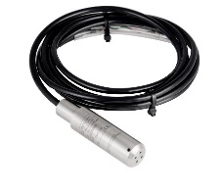
Equipment and task: Reflection by the participants.
Water Level Sensor
A water level sensor is a device that relays information back to a control panel to indicate whether the aquifer has a high or low water level.

Slide 22
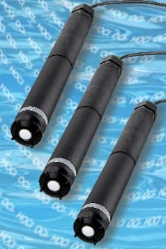
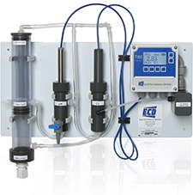
Equipment and task: Reflection by the participants.
Chlorination Sensor and Monitoring
Chlorination Sensor used in DWASA SCADA System shows if the chlorination unit is active or inactive. The Chlorination chamber has separate monitoring of the chlorine system.

Slide 23
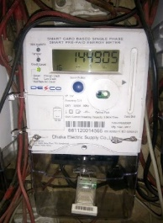
Equipment and task: Reflection by the participants.
Electric Meter
Electric Meter is sued to measure the amount of electricity use. This meter is also connected with SCADA system so that the energy consumption can be monitored.

Slide 24
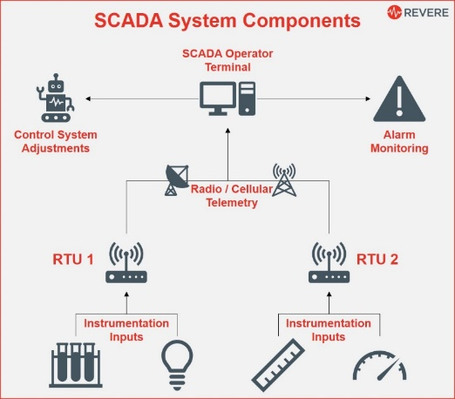
Equipment and task: Reflection by the participants.
RTU (Remote Terminal Unit)
Sensors and process controller devices are attached to remote terminal units (RTU). Multiple remote terminal units at different sites transmit the data collected to a single master station which displays the information in a browser.

Slide 25
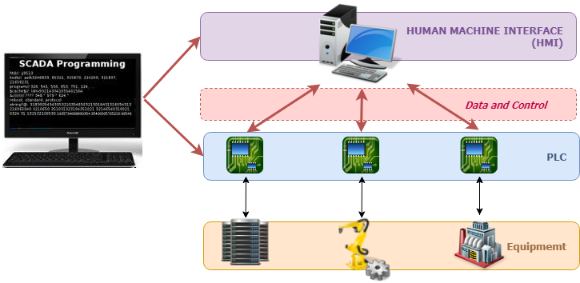
Equipment and task: Reflection by the participants.
PLC (Programmable Logic Controller)
Data from sensors on individual assets is transmitted to the PLC. The PLC translates that data into a format that can be used by the software. Users access the data through the HMI on the software. If the data crosses certain thresholds, a maintenance work order is created.

Slide 26
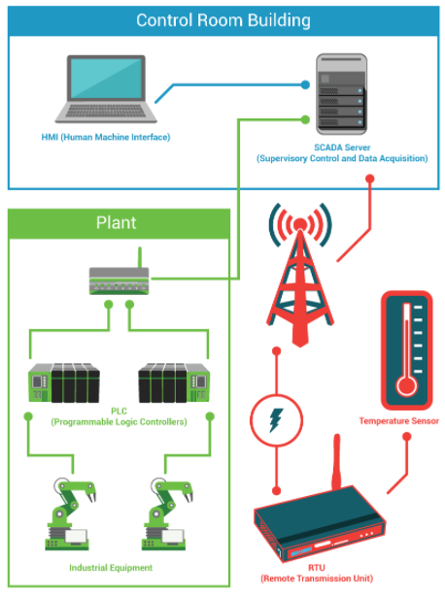
Equipment and task: Reflection by the participants.
HMI (Human-Machine Interface)
An HMI SCADA system, or SCADA Master, can provide several helpful extensions for network alarm management of monitoring equipment. If connected to an RTU, the gathered data can be filtered, analyzed, and monitored against functional standards. Out-of-range data can generate alerts to operators or maintenance personnel as required.

Slide 27
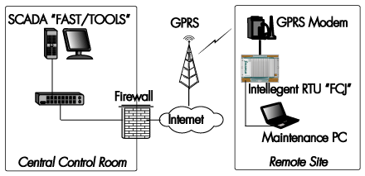
Equipment and task: Reflection by the participants.
Internet/radio frequency/GPRS
Wireless SCADA systems are the ones in which the communication between the Remote Terminal Unit (RTUs) and Human Machine Interface (HMI) is wireless in nature. General Packet Radio Service (GPRS) is the commonly used wireless technique used in wireless SCADA systems.

Slide 28
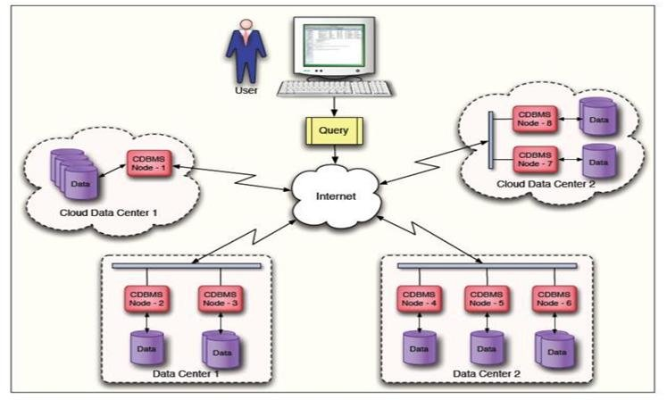
Equipment and task: Reflection by the participants.
Data base, cloud, server, SD card
To store the data and operated the equipment.

Slide 29
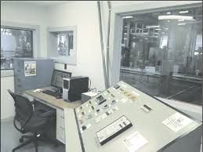
Equipment and task: Reflection by the participants.
Physical facility, Computer, Laptop, mobile, tablet, staff, and panel
To see the data and use it accordingly. Reading and analyzing.

Slide 30
SCADA and Maintenance
SCADA is a useful tool for monitoring and operation of the equipment.
SCADA is providing detailed information about the running of the machine. This can be used to customize a maintenance plan.

Slide 31
Maintenance quiz (1)
Divide in 2 groups
The participants will show wrongly installed photographs.
If the group can identify what was installed incorrectly, they will get a point.
If they explain how it should be done instead, they will get a bonus point.

Slide 32
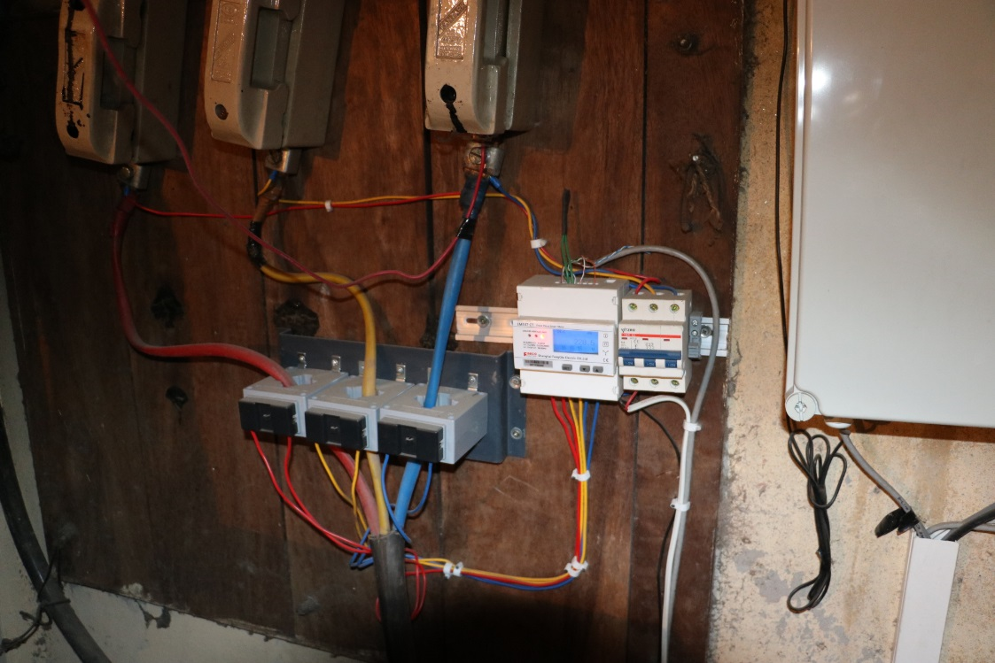
Maintenance quiz (2)
Photograph 1: What is wrong?

Slide 33
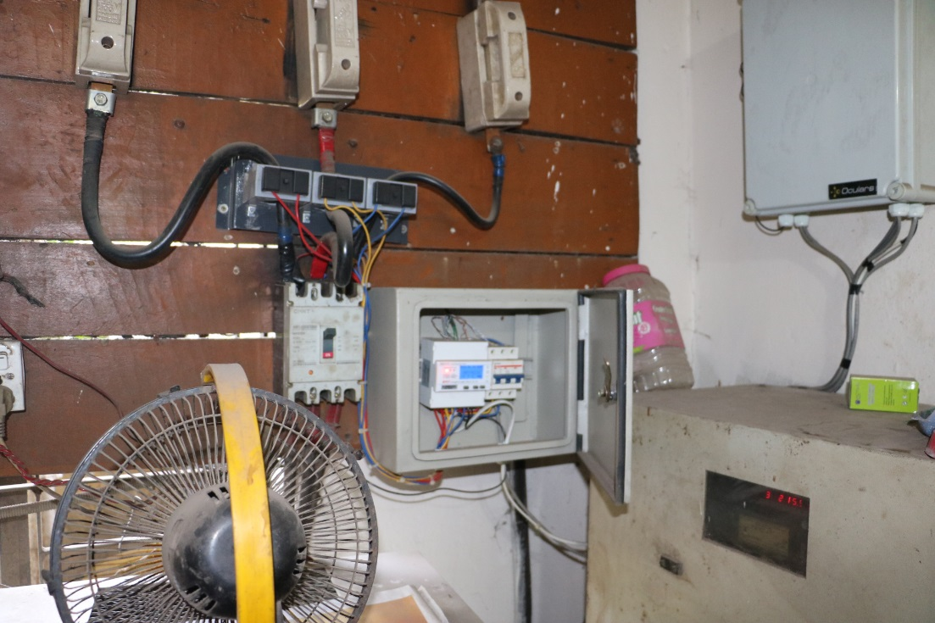
Photograph 2: What is wrong?
Maintenance quiz (3)

Slide 34
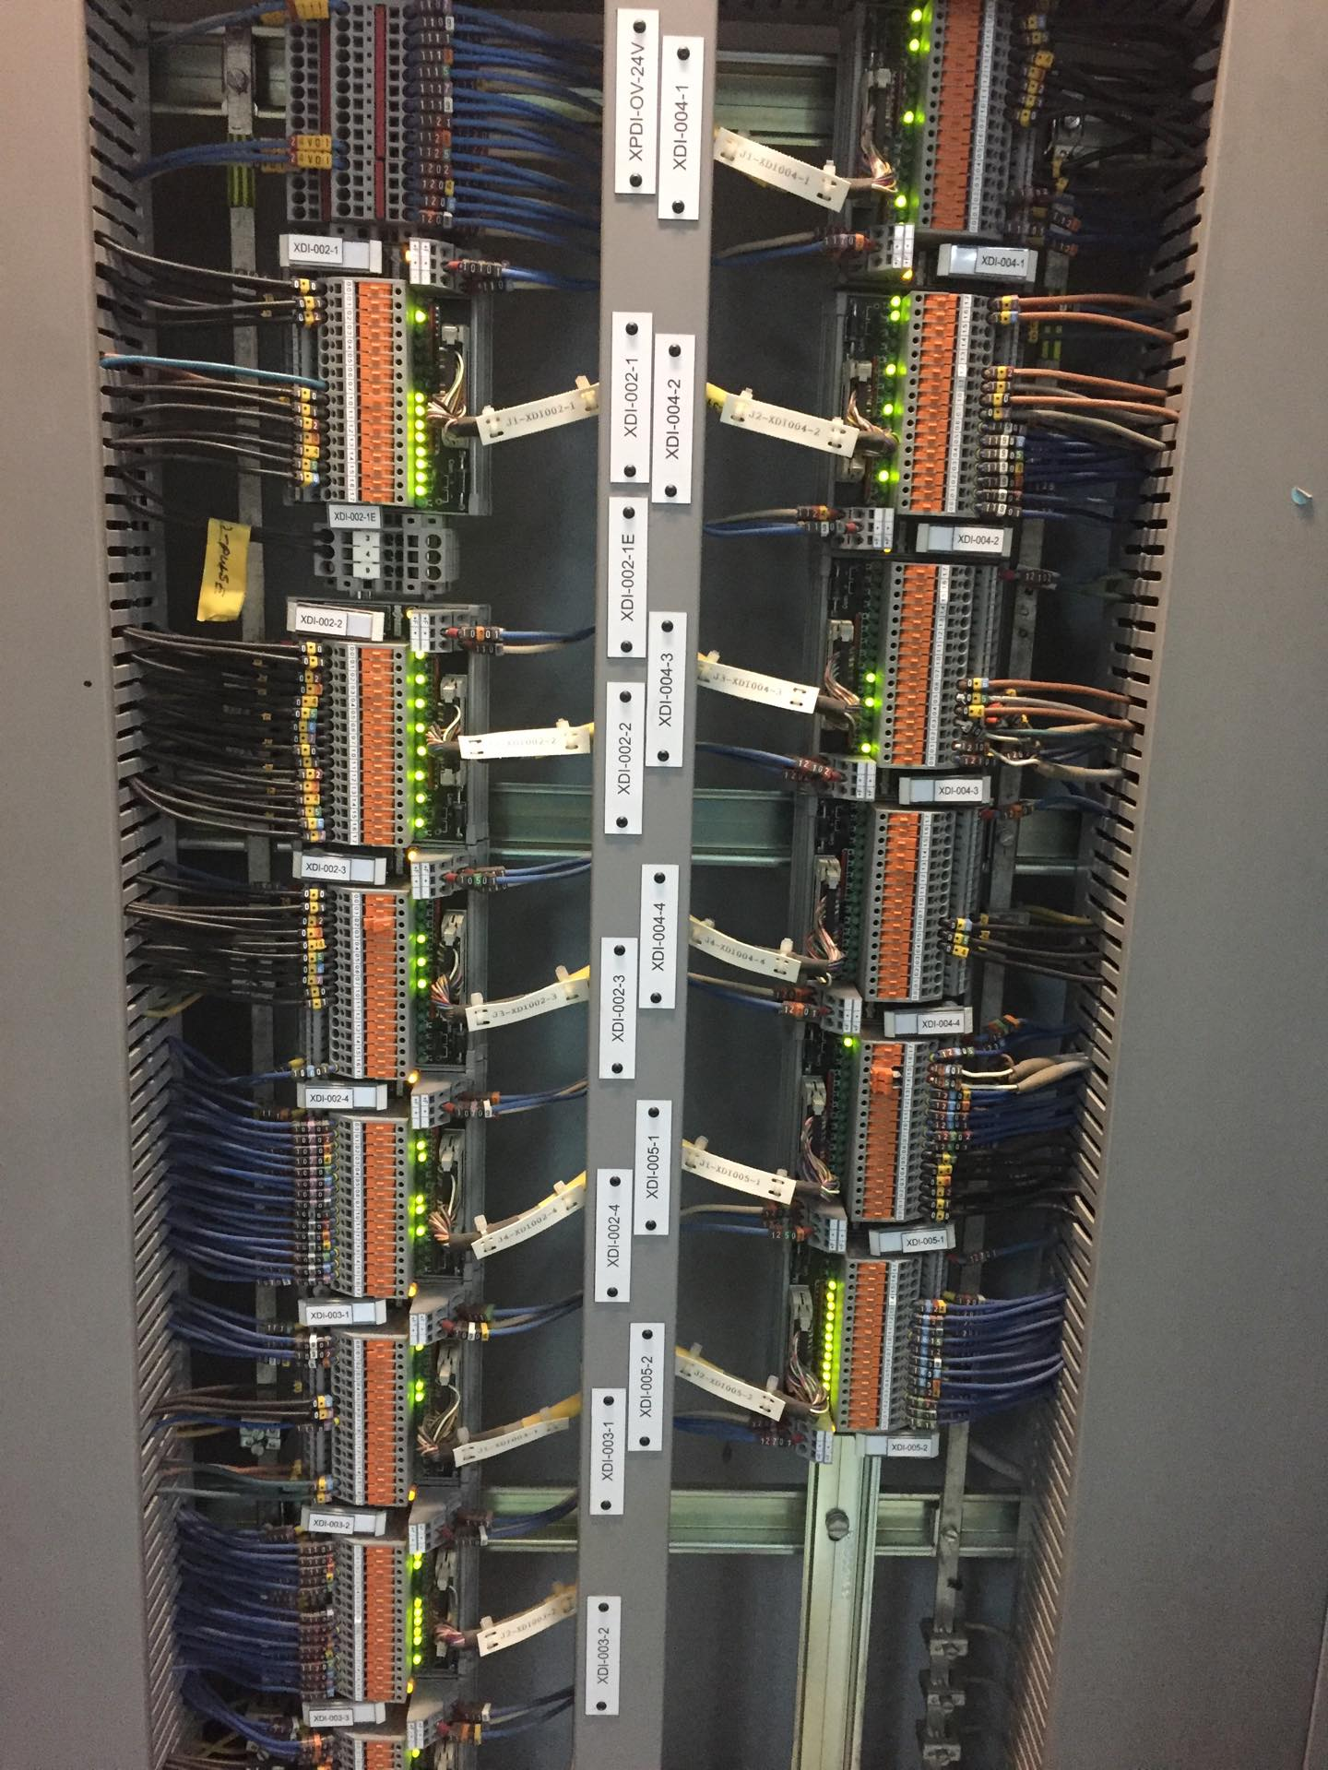
Photograph 1 & 2: Correct installation
Maintenance quiz (4)

Slide 35
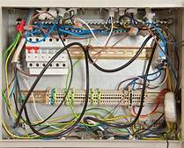
Photograph 3: What's wrong?
Maintenance quiz (5)

Slide 36
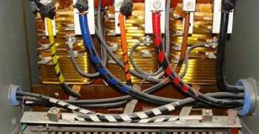
Photograph 3:Correct installation
Maintenance quiz (6)

Slide 37
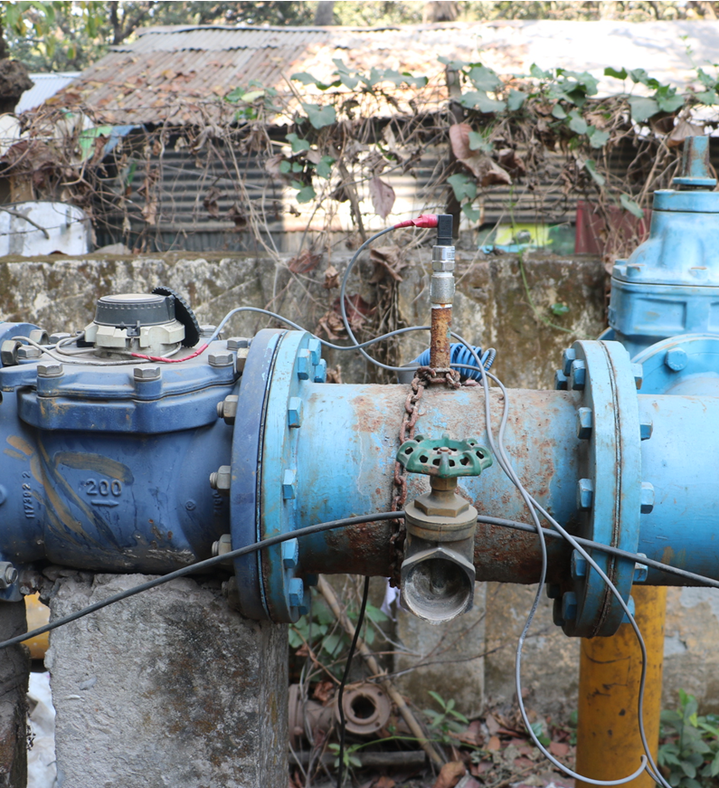
Photograph 4: What’s wrong?
Maintenance quiz (7)

Slide 38
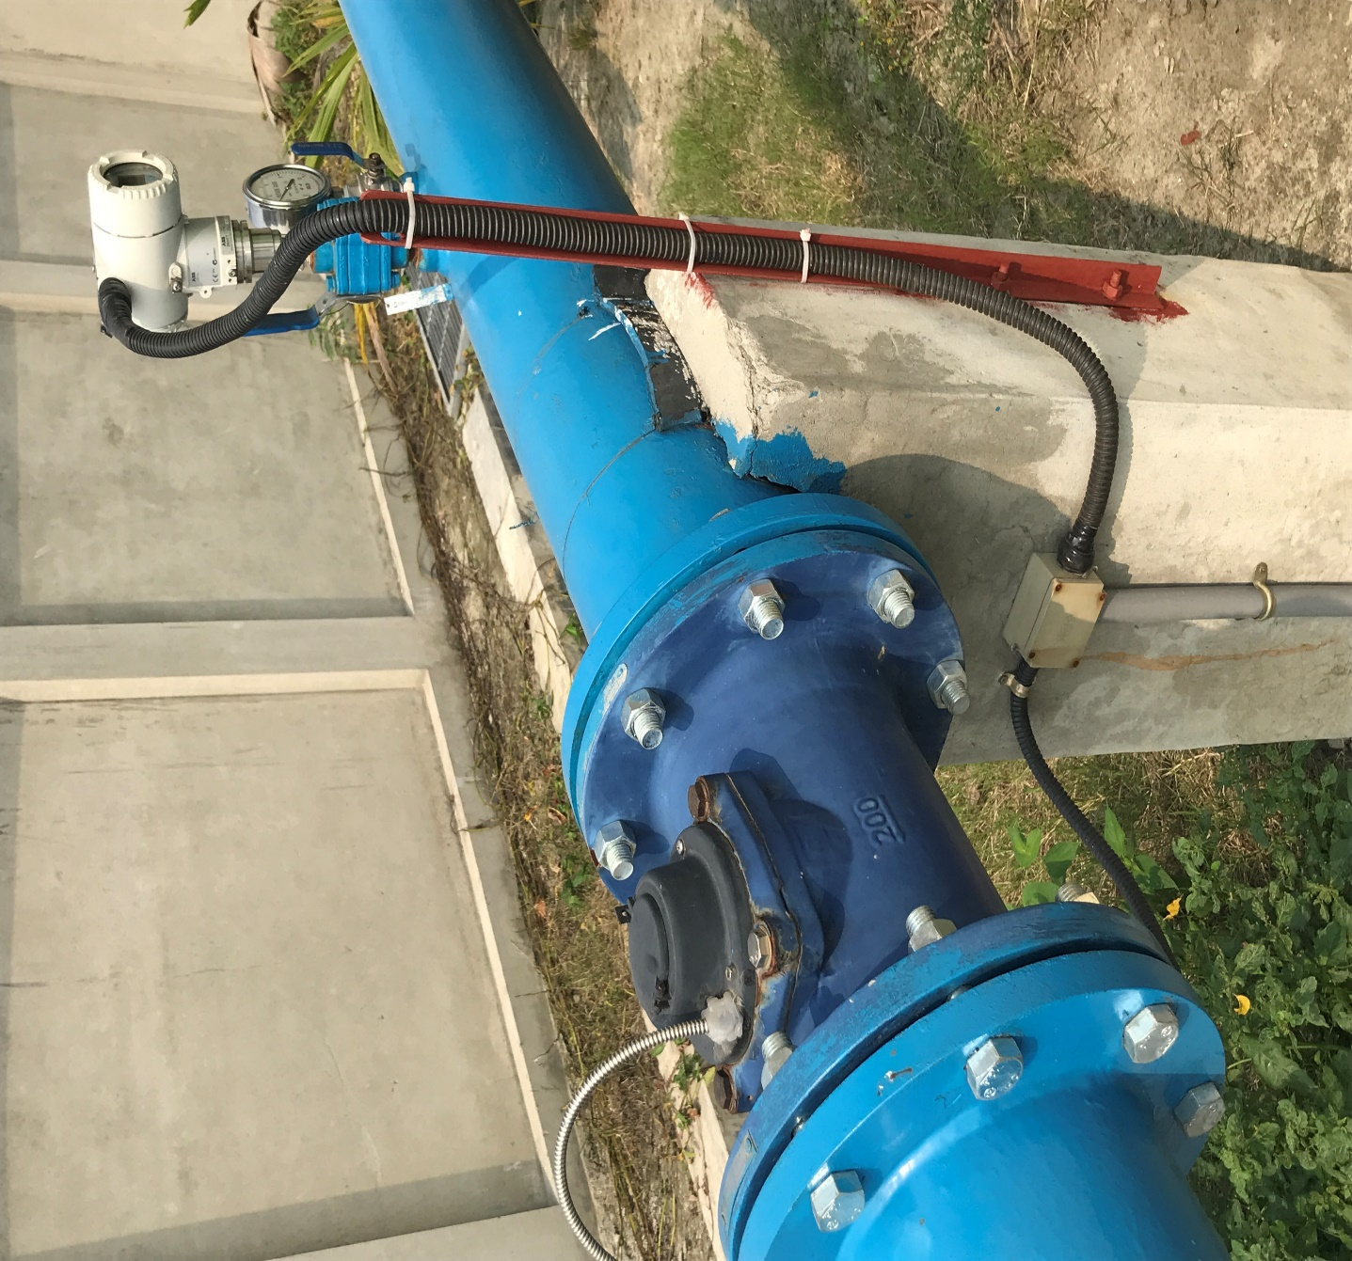
Photograph 4: Correct installation
Maintenance quiz (8)

Slide 39
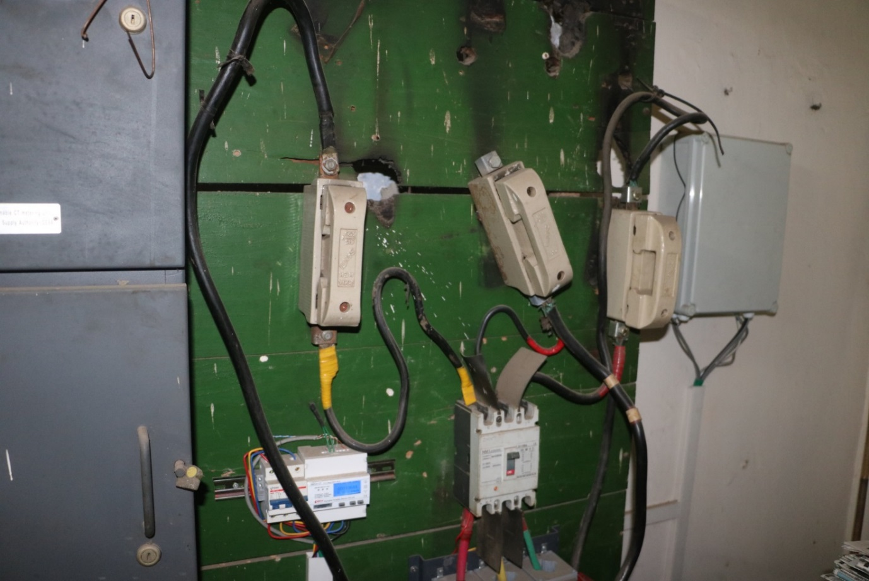
Photograph 5: What’s wrong?
Maintenance quiz (9)
Notes:
Wat is wrong?
The middle fuse is bypassed
Fuses are as small as needed, just to provide in what the pump needs.
Now the pump is not protected and might burn out(verbranden)
BUT ALSO IT MIGHT CAUSE TO DEATH
If the area is cleaned up, the equipment will last longer.
The dust will damage the electonics. Keep cabinets closed. Clean on regular times

Slide 40
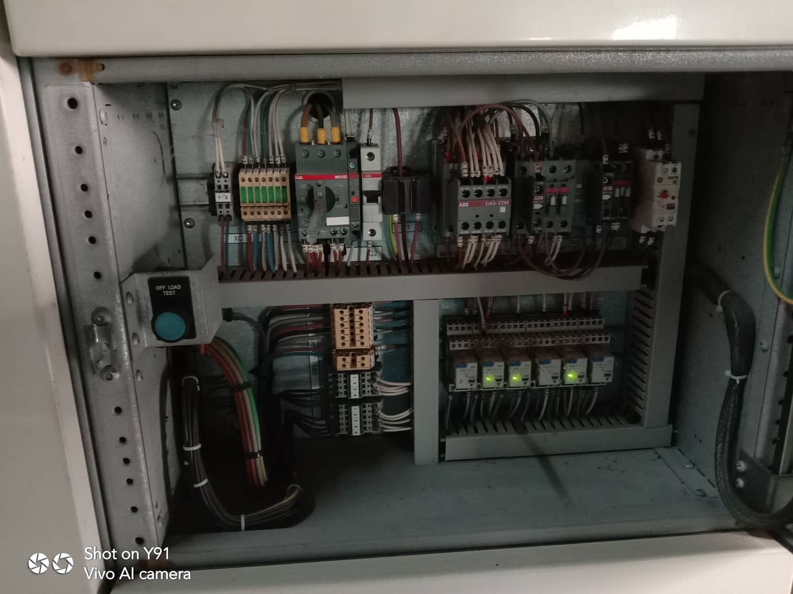
Picture 5: Correct installation
Maintenance quiz (10)

Slide 41
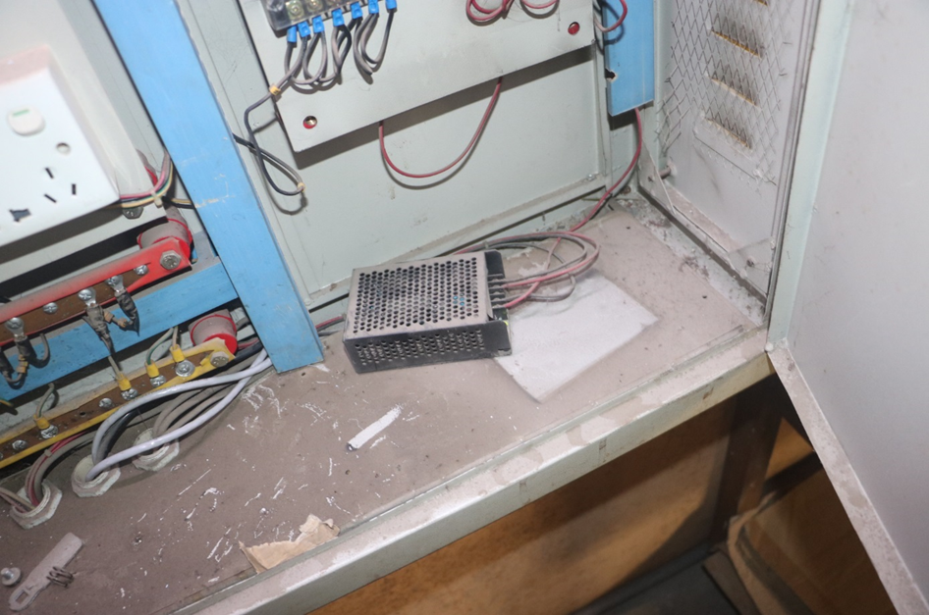
Photograph 6: What’s wrong?
Maintenance quiz (11)

Slide 42
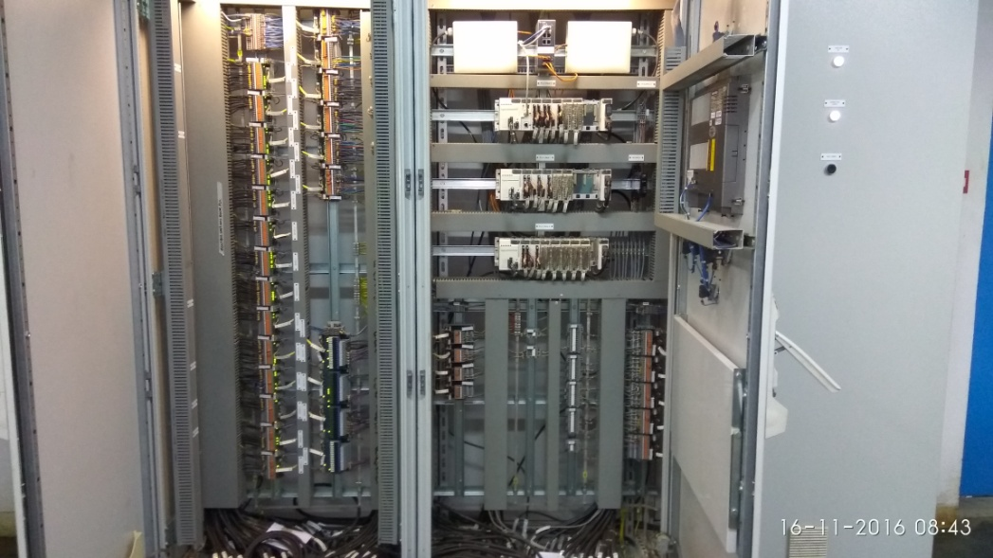
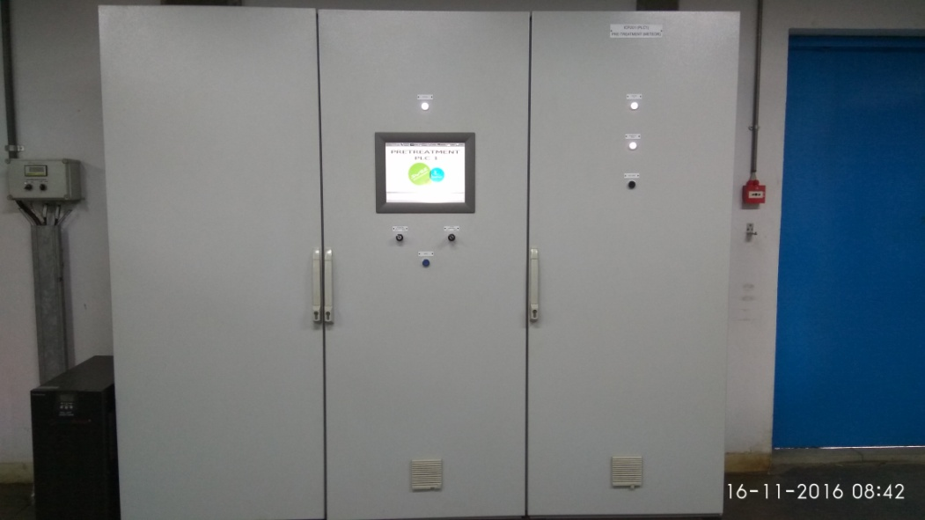
Maintenance quiz (12)
Picture 6: Correct installation

Slide 43
Proper installation & maintenance (1)
Question to you:
Why is proper installation & maintenance important?

Slide 44
Proper installation & maintenance (2)
Answer: Importance of proper installation and maintenance.
Life expectancy of equipment
Cost reduction
Safety

Slide 45
Importance of the site survey and pay attention to the detail
After equipment has been installed, a site survey visit needs to be conducted to check if the equipment is installed properly.
Is everything installed properly according to the contract.
Let's have a look on some photographs and reflect…

Slide 46
Site survey
This is what you pay for
This is what you get

Slide 47
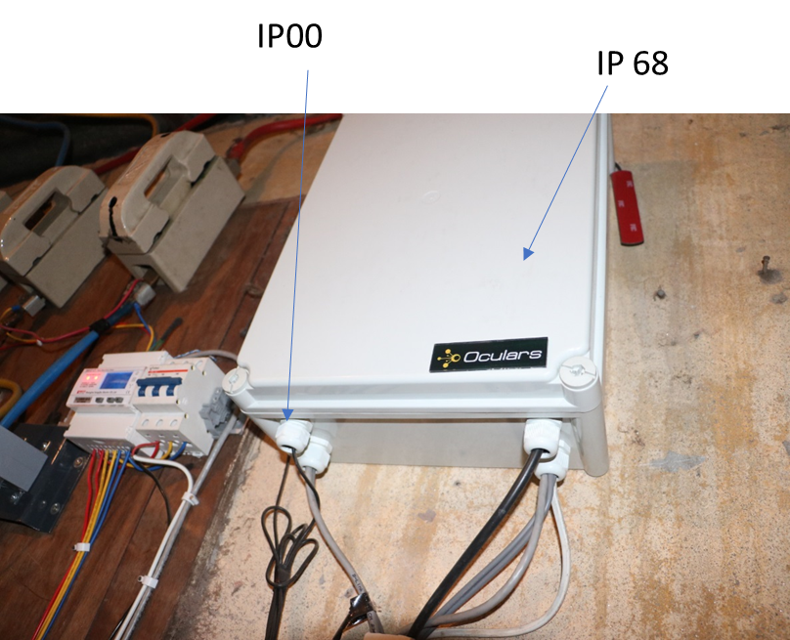
Pay attention to the details! (1)
The site acceptance test is of great importance.
Here you check if the quality of installation is good enough.

Slide 48
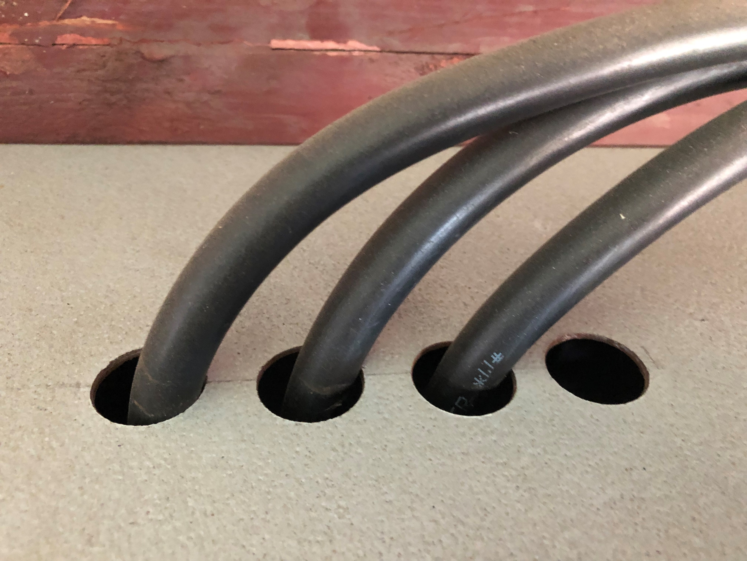
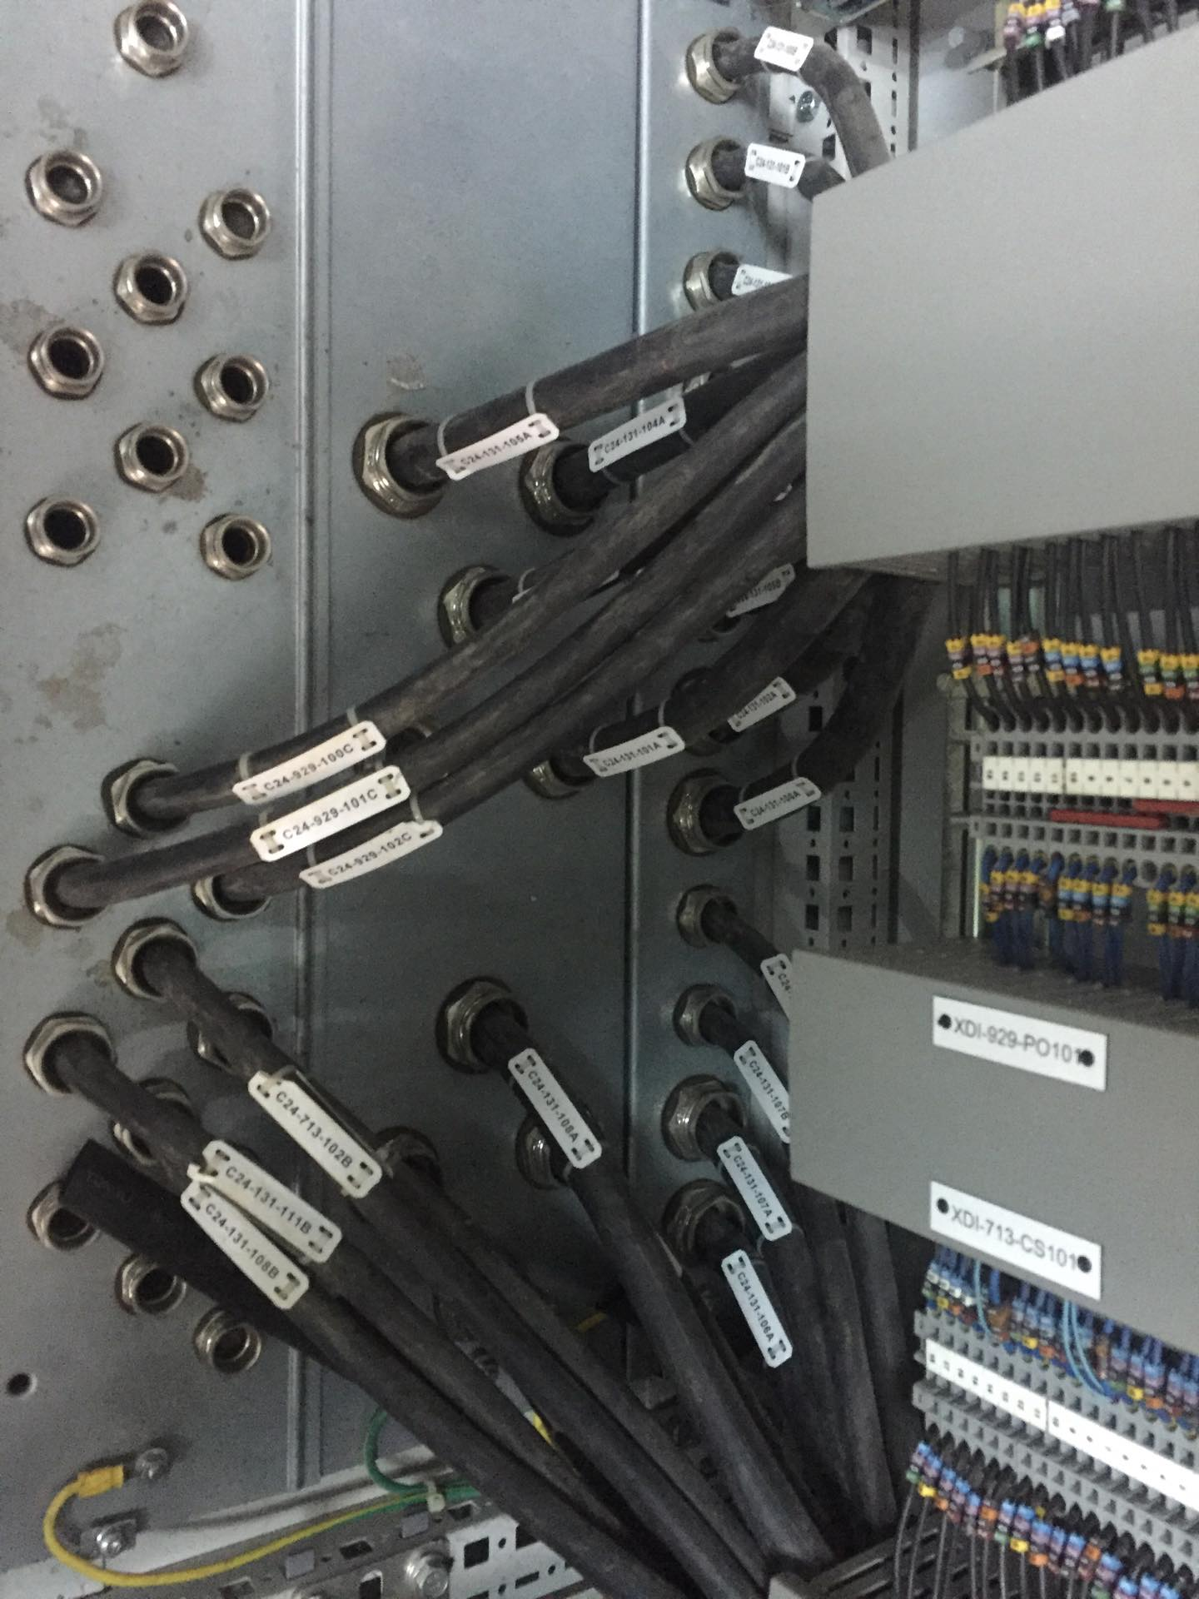
Wires and cables should be lined up ,coated and tagged. Connections should be watertight.
This is what you get
This is what you pay for
Pay attention to the details! (2)

Slide 49
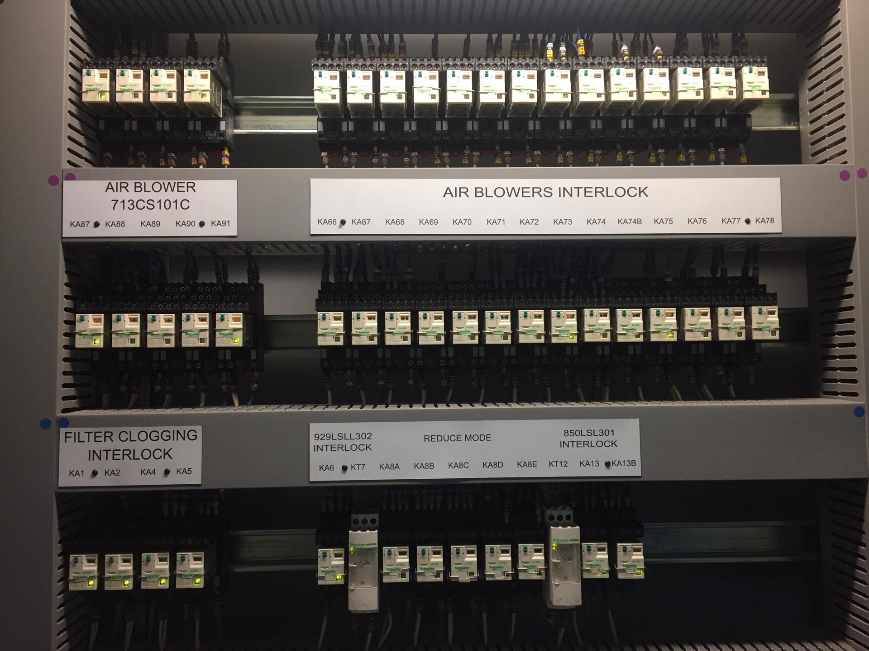
The chamber is covered, proper channels are there, and tag numbers are there.
Pay attention to the details! (3)

Slide 50
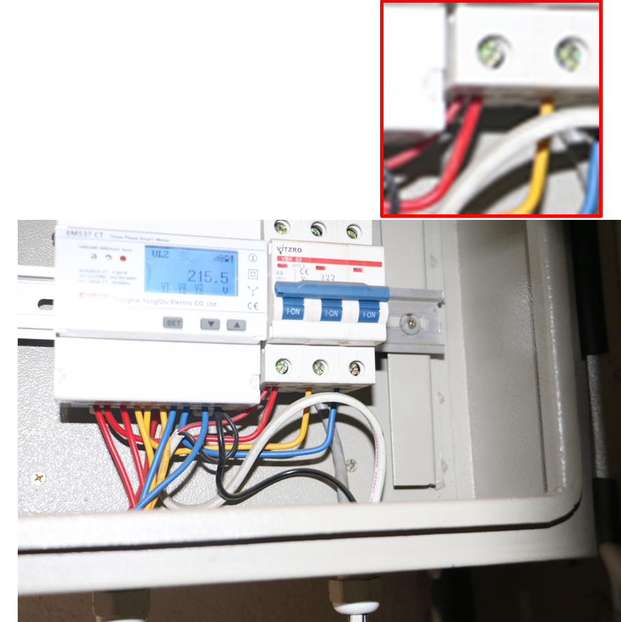
Pay attention to the details! (4)
Different size of wires underneath one screw. The smallest wire is loosely connected.

Slide 51
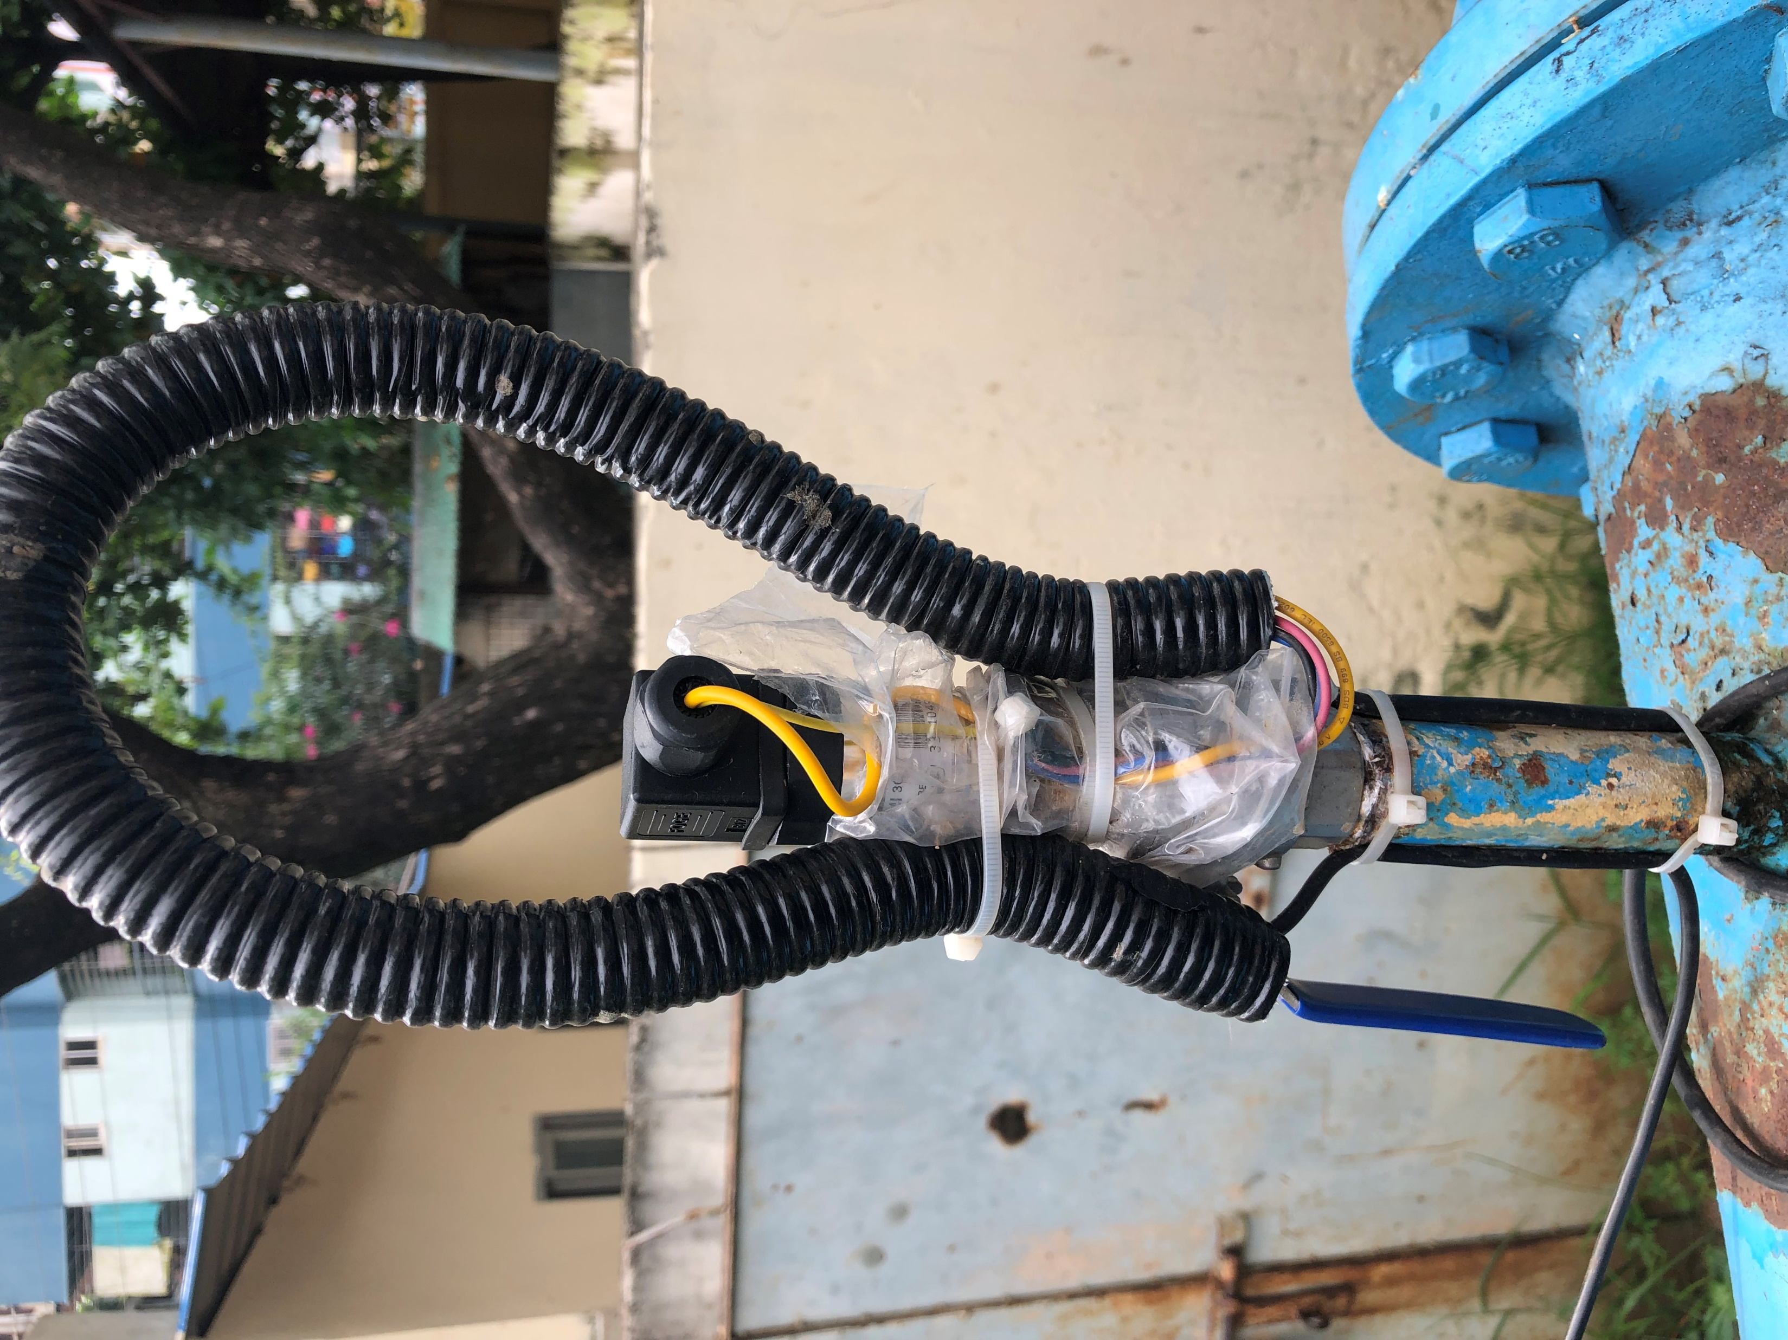
Pay attention to the details! (5)
The cable line and the machine are not properly covered by a box. The plastic is not a proper solution to cover equipment.

Slide 52
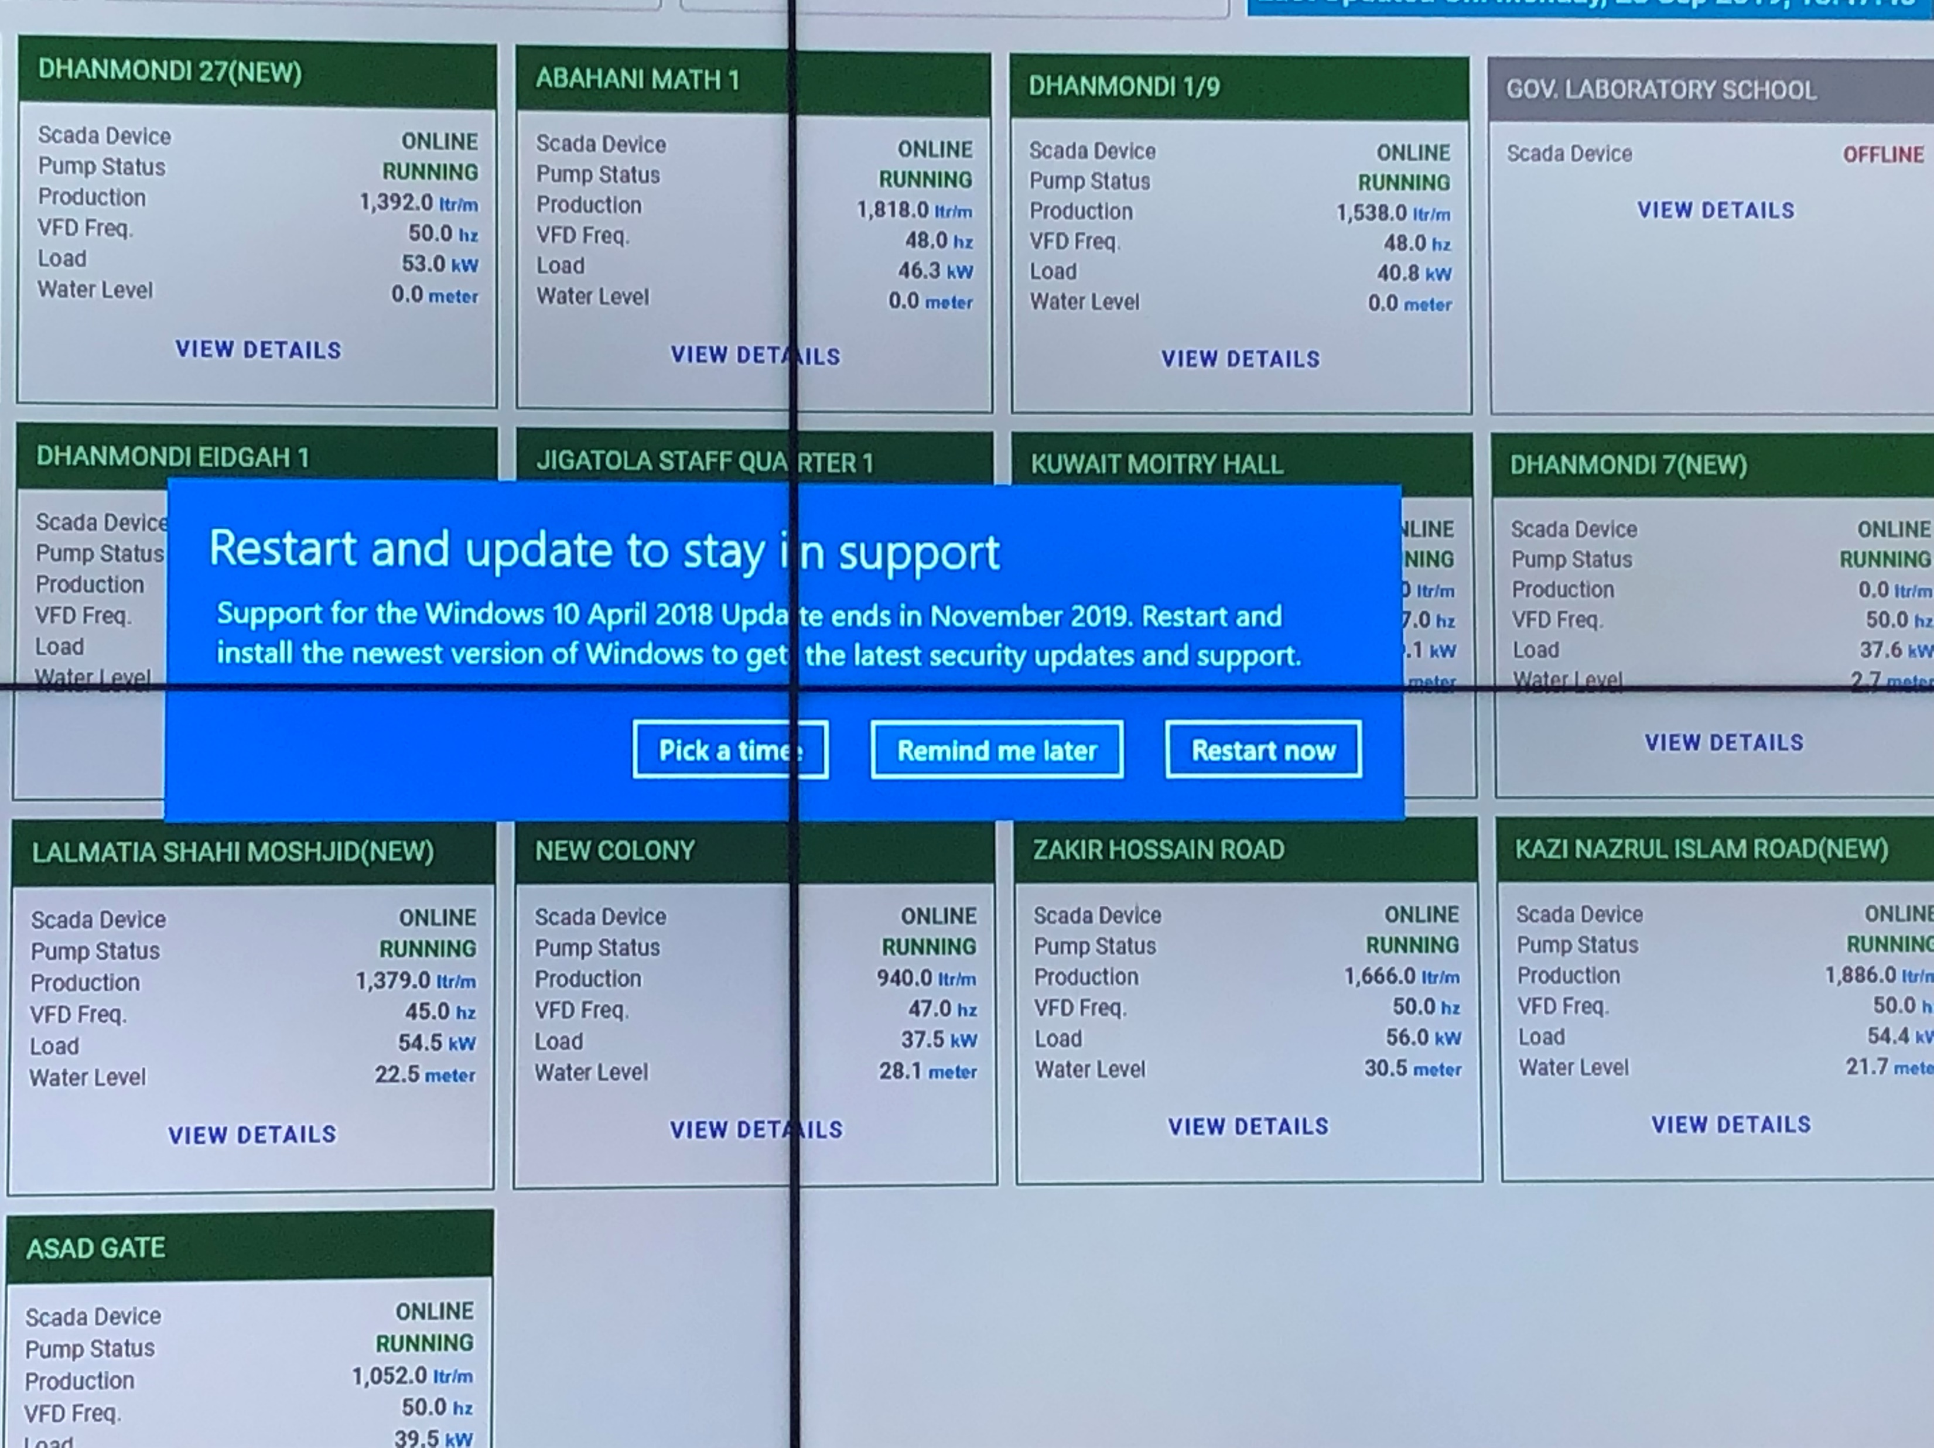
Take care of the security system of SCADA (1)
Brainstorm on the following questions in small groups;
What is the problem?
Why is this a problem?

Slide 53
Take care of the security system of SCADA! 2
The possible solution can be;
Update your windows.
Using firewall.
Using the antivirus system and update it regularly.

Slide 54
Wrap-up the day
That is it for today!
Any questions?

Slide 55
Recap of the day 1
Three question for recap in group:
What was your eye-opener from the training of yesterday?
What is your most important learning from the training?
How will you use this in your job?
What is the most difficult topic in the training and why?

Slide 56
Planning for day-2
Time | G1 | G2
9.30-9.50 | Introduction
9.50-10.50 | Pump visit | SCADA room visit and do the exercise
 | Reflection on pump visit
 | Tea-break
10.50-11.50 | SCADA room visit and do the exercise | Tea-break
 |  | Pump visit
 |  | Reflection on pump visit
11.50-1.00 | Plenary reflection on SCADA room visit

Slide 57
Field trip to the SCADA pump.
Now you will go to visit a pump that is located in the yard of the training center. This pump has installation of SCADA equipment.
They have to collect information according to a checklist which they will have now.
They have to write their observation in the column too.
Distribute the checklist to the participants.

Slide 58
Reflection on the SCADA pump visit: Group exercise
The group will come back to the training venue. They will reflect on their visit experience to the pump.
In group: Following the checklist, prepare a presentation;
What is the reading of the different meters?
What do you think about the maintenance of the equipment?
What is good and what could be improved?
Who in your opinion is responsible for the maintenance?

Slide 59
Visit to SCADA room
Participants will visit a SCADA room where server and control panel are installed.
Each of them will have a questionnaire and according to this questionnaire they have to look at a specific pump that operated by SCADA system.
They have to open specific pump and need to collect the information’s that has given in the questionnaire.
After collecting the information by all of them, they will come back to the training venue and there will be a reflection session held.
Distribute the questionnaire.

Slide 60
Plenary reflection on the SCADA room visit
Both teams will do a reflection session on their experience in SCADA room focusing on the following questions;
What is their learning from the SCADA room?
How do they use the data that they collect from the SCADA room in their work in DMA’s? Include the following issues in your answer.
Operation
Monitoring
Maintenance
What can they do if they find something wrong going in the SCADA system?

Slide 61
Wrap up the day
Ask them, do they have any last question?
Provide post-test and evaluation form.
Collect it after finishing.
Certification & thanks.

